Slide 1




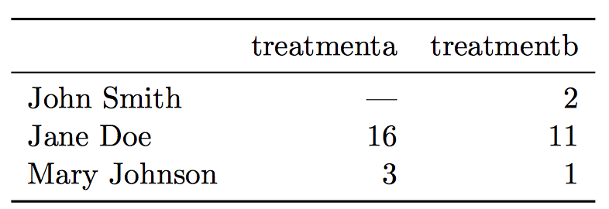
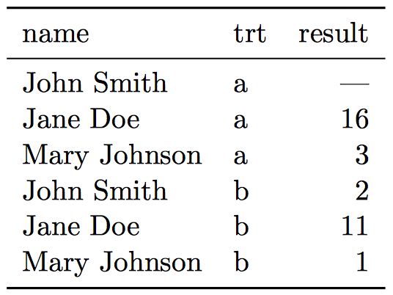
Analyzing Weather Impact on Ambulance Response Time
¹Rensselaer Polytechnic Institute, Tetherless World Constellation, Troy, NY, United States
Shrey Jain – jains6@rpi.edu
Introduction
Data Analysis
Due to the development of experimental and analytic equipment, large amounts of scientific data are being produced all over the world. The rapidly increasing volume and variety of geoscience-related data give researchers opportunities to answer scientific questions that are hard to solve using traditional methods. However, most of the time, raw data are not directly usable because of their hierarchical structures, missing values, inaccuracy, duplication, and so on. Also the data format needs to be adapted to different analytic techniques. It is often said that 80% time of data analytics is spent on data cleaning and preparing. Therefore, data processing is a crucial part of the data analytics pipeline, and iterative processing is needed when new problems emerge or secondary data are generated, throughout the whole analytics procedure. This poster will mainly focus on data processing and preparation. We start by introducing the principles for cleaning datasets, followed by some quick data exploration methods. Then we demonstrate some ways of dealing with various problems, such as missing values or duplication, in the datasets. The last part of the presentation show applications in real geoscientific datasets.
Data Preparation Steps:
Quality Assessment
Data Cleaning
Data Munging
EDA
Model Prep
Inspiration
It is crucial to know the estimated arrival time of an Ambulance in case of any emergency.
This could help provide pre-hospital care to the patient which could save many lives.
Weather can have impact on Ambulance times.
This project performs data pre-processing, identifies relation between Weather & EMS data and develops model to predict future response times in any given weather condition.
Data Sets
Results
Conclusion
EMS Dataset
Provided by Fire Department of New York City
11863759 number of rows
32 number of columns
The target column to be predicted using various machine learning regression models is INCIDENT_RESPONSE_SECONDS_QY
Weather Dataset
Provided by Global Historical Climatology Network
3288 number of rows
34 number of columns
Weather on a particular date is used to link these datasets. Datasets are joined using INCIDENT_DT column of EMS and DATE column of Weather dataset
Each variable forms a column
Each observation forms a row
Each type of observational unit forms a table
Each variable forms a column
Each observation forms a row
Each type of observational unit forms a table
Untidy table
Untidy table
Better for
reporting
Better for
analysis
Better for
reporting
Better for
analysis
Tidy table
Tidy table
Glossary
References
EDA: Exploratory Data Analysis
R: A programming language like Python
Library(R): Load packages containing useful functions
EMS: Emergency Medical Services
Boxplot: Graphical Representation of five num
R Basics: https://towardsdatascience.com/r-basics-everything-you-need-to-know-to-get-started-with-r-10c8e566d7b3
Scrape-R Package: https://cran.r-project.org/web/packages/scrapeR/scrapeR.pdf
Read Excel File in R: https://www.datacamp.com/community/tutorials/r-tutorial-read-excel-into-r
Dealing with missing data in R: https://www.statmethods.net/input/missingdata.html
Visualization in R: https://www.analyticsvidhya.com/blog/2015/07/guide-data-visualization-r/

